Slide 1
Analyzing the Characteristics of Police Shooting Incidents in Economically and Racially Different Areas with Qiskit
Team 11: Ming Zhang, Yijun Wu, Peixuan Huang, Chelsea Zhang

Slide 2
Overview
Problem and Objective
Methodology
Model
Results

Slide 3
Central Problem and Objective
Police shooting has always been a critical social issue in the U.S. In this Hackathon project, using the police shootings data (victim characteristics) and the city level data (economics, education, race share), we attempt to analyze if there are significant differences in the types of shooting cases based on the socio-economics condition of the areas they happen.
For example, one question can be, do shooting cases tend to include low threat level victims armed with non-lethal weapons in areas with more poverty and minority rate?

Slide 4
Methodology
Classify shooting cases into city clusters
Classify shooting cases into location clusters
Inference
Clustering on the city level data
Inference
Clustering on city level data
Generate cluster zones that can be characterized by wealth, poverty, education level, and share of race population.
Proposed methods:
Qiskit Max_Cut; K-means implementation using Qiskit; scikit-learn K-means (if Qiskit fails)
Predict which location cluster a shooting case belongs to.
Proposed methods:
Qiskit QSVM; scikit-learn Random Forest classifier (if Qiskit fails)
Infer on the importance of variables involved in a shooting case based on where it happened
Proposed methods:
Random forest variable importance
Notes:
Clustering on the city level data. This will generate cluster zones that can be characterized based on their wealth, poverty, education level, and share of race population. Then we would like to profile the clusters or infer on the different variables and features of the shooting cases happening in those location clusters.
Proposed methods: Qiskit Max_Cut; K-means implementation using Qiskit; scikit-learn K-means (if Qiskit fails)
Run a predictive model that predict which location cluster a shooting case belongs to. The purpose is to infer on the importance of variables involved in a shooting case based on where it happened.
Proposed methods: Qiskit QSVM; scikit-learn Random Forest classifier (if Qiskit fails)

Slide 5
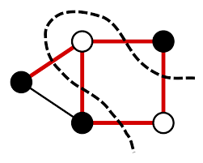
Clustering with qiskit
Max-cut:
Generate a distance matrix for each pair of entries, and use that matrix for the max-cut optimization. The weighted Max-Cut problem is equivalent to minimizing the Ising Hamiltonian.
Problems:
Have to run hierarchy clustering for 2+ clusters problem.
Unbelievable runtime for more than 20 entries.
Don’t know how to tune the number of qubit efficiently.

Slide 6
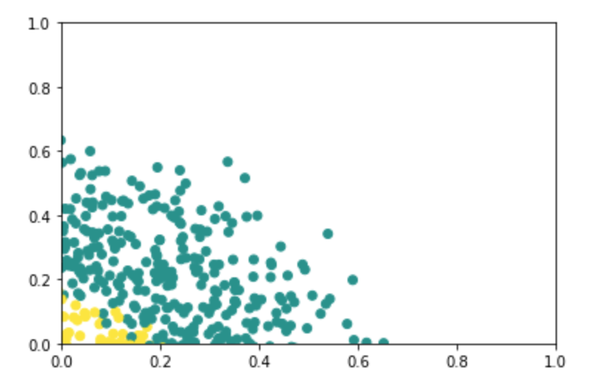
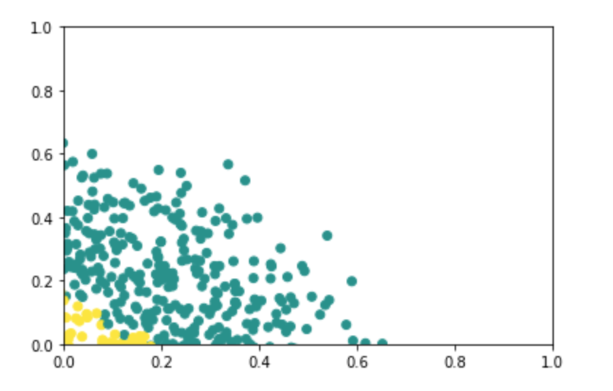
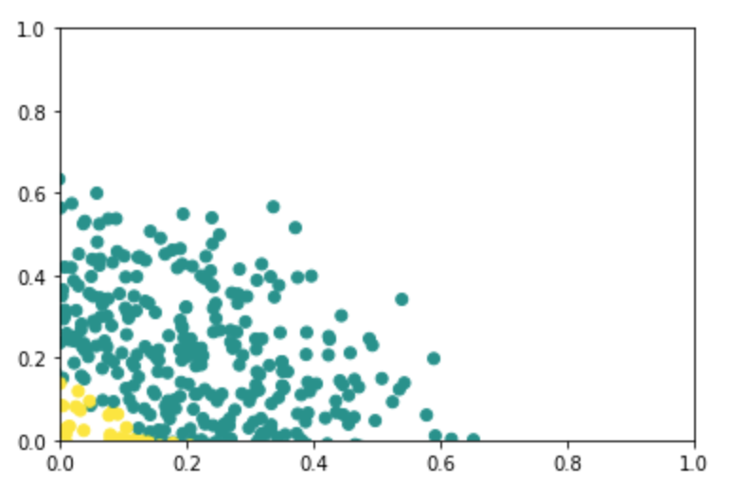

Clustering with qiskit
Use quantum distance metric and implement Kmeans algorithm by hand:
Not able to explain the distance metric (not very good at physics).
Can converge but still slow (about 10 second per iteration).

Slide 7
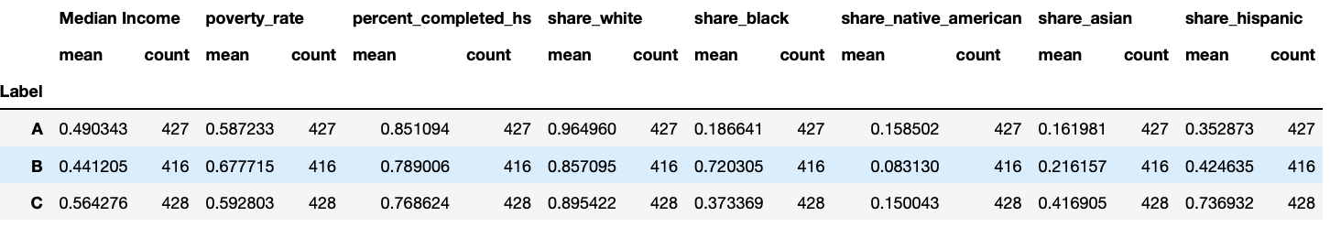
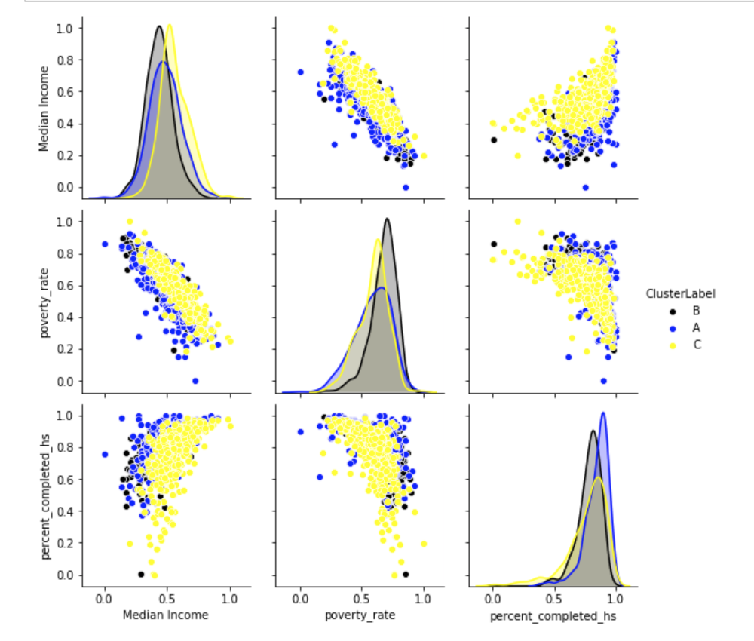
Model: K-means clustering
Cluster A: Mostly White, high percentage completed high school
Cluster B: Mostly Black, high poverty rate, low median income
Cluster C: Mostly Hispanic and Asian, high median income

Slide 8
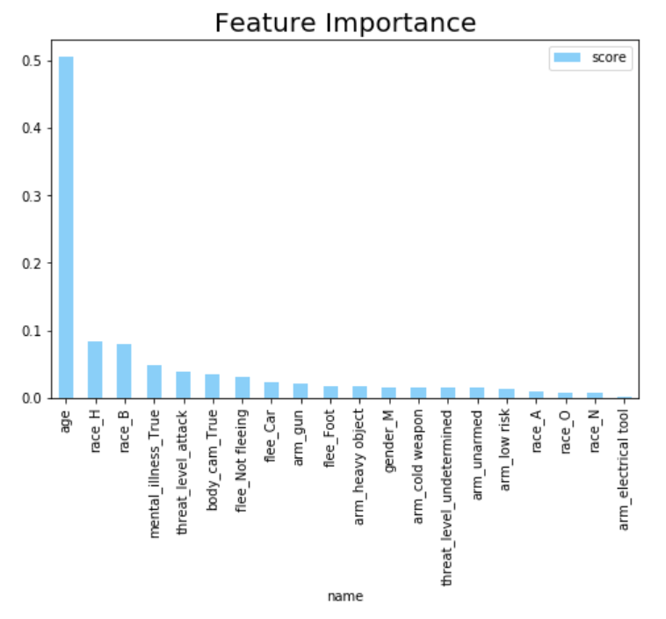
Model: Random Forest
Use random forest to classify shooting cases into the 3 clusters
Important variables:
Age
race_H
race_B
mental_illness_True

Slide 9
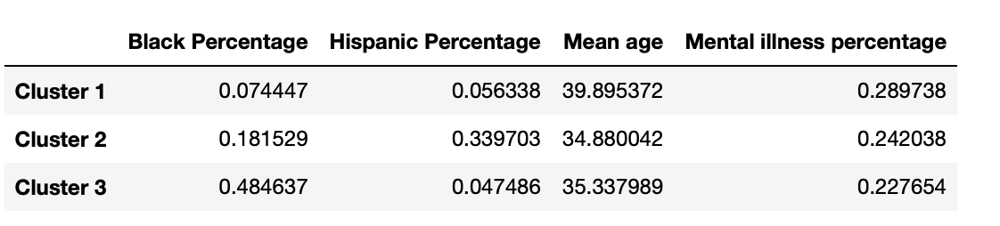
Profiling on the area clusters
Cluster 1 ( Mostly White, high percentage completed high school): cases more likely to include suspects/victims with higher age and signs of mental illness
Cluster 2 (Mostly Black, high poverty rate, low median income): more cases involving Hispanics even though the percentage of black population is higher
Cluster 3 (Mostly Hispanic and Asian, high median income): most cases involving black suspects/victims

Slide 10
Thank you

